Slide 1
Data Science
Correlation
Lecture No. 3c

Slide 2
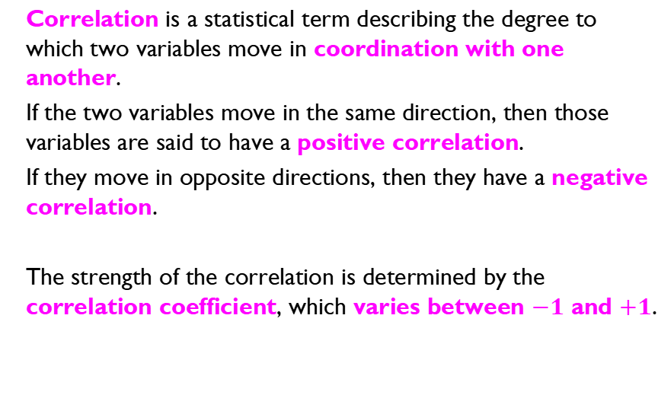
Correlation
What if correlation is 0?

Slide 3
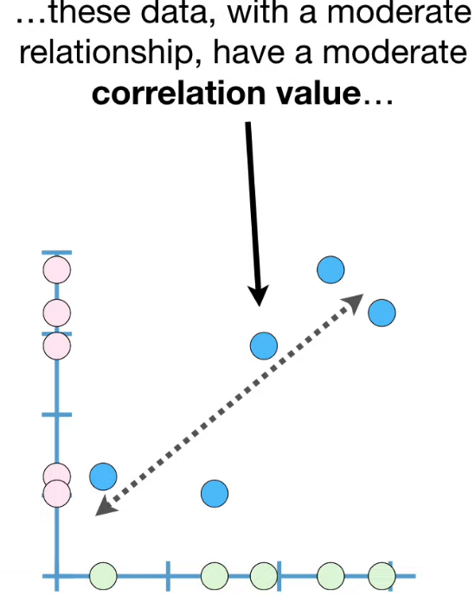
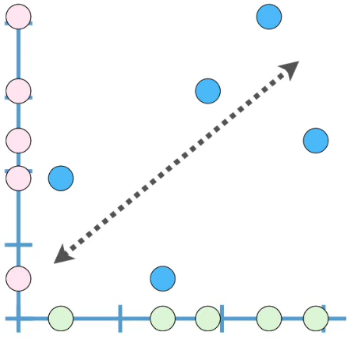
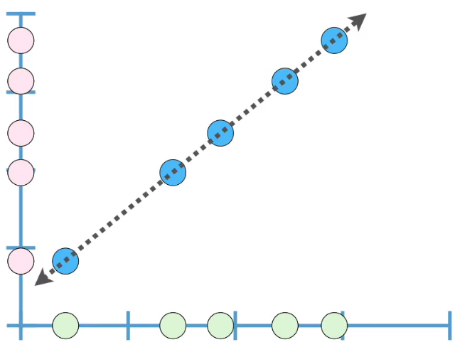
Correlation Between Two Variables
Correlation is 1 if a straight line with positive slope can be drawn from the center of all data points
Weak relationship have small correlation value…
Strong relationship have large correlation value…

Slide 4
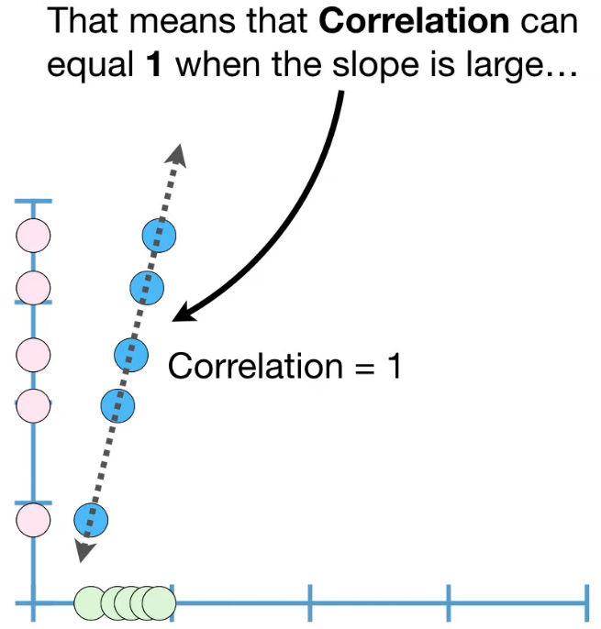
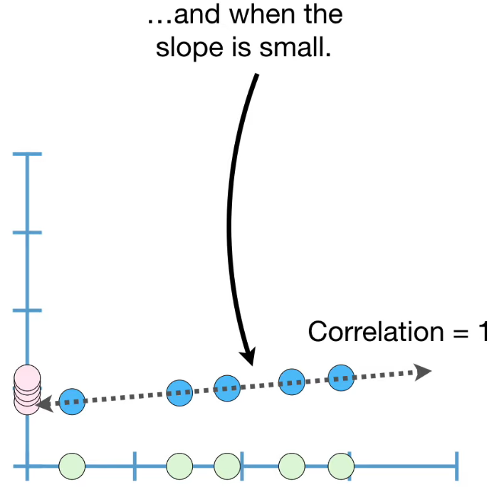
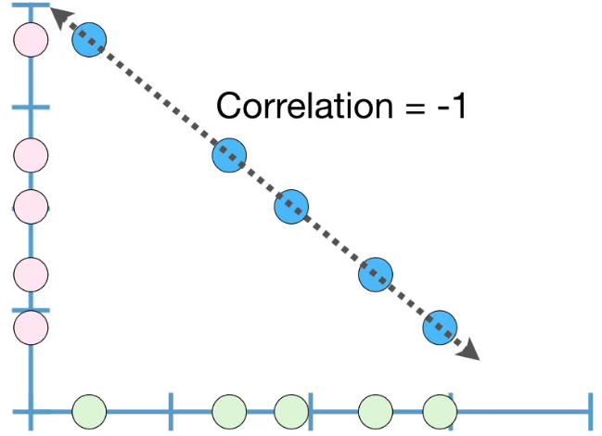
Correlation Between Two Variables

Slide 5
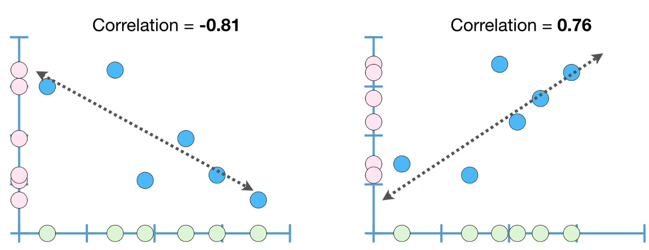
Correlation Between Two Variables

Slide 6
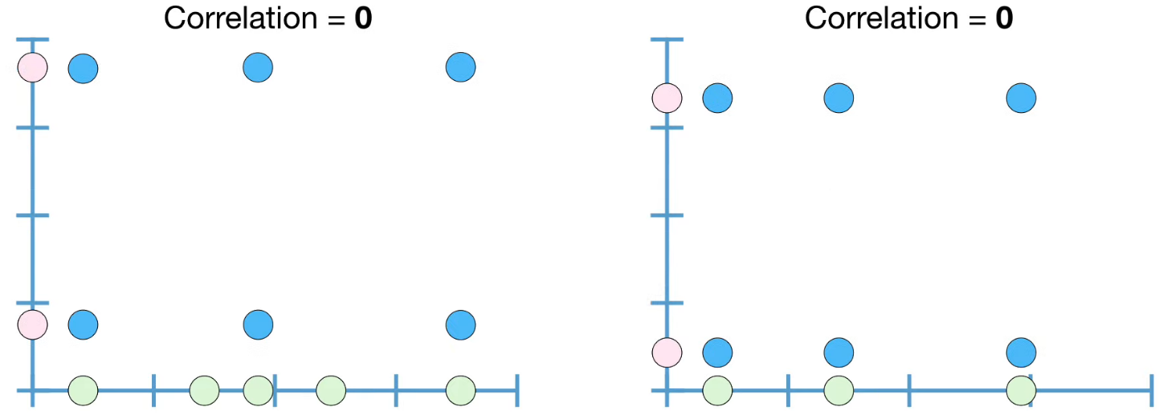
Correlation Between Two Variables
But … How to Compute Correlation?

Slide 7
Computing Correlation
X | Y
1 | 2
2 | 4
3 | 7
4 | 9
5 | 12
6 | 14
X | Y | XY
1 | 2
2 | 4
3 | 7
4 | 9
5 | 12
6 | 14

Slide 8
Computing Correlation
X | Y
1 | 2
2 | 4
3 | 7
4 | 9
5 | 12
6 | 14
X | Y | XY
1 | 2 | 2
2 | 4 | 8
3 | 7 | 21
4 | 9 | 36
5 | 12 | 60
6 | 14 | 84

Slide 9





Computing Correlation
X | Y
1 | 2
2 | 4
3 | 7
4 | 9
5 | 12
6 | 14
X | Y | XY
1 | 2 | 2 | 1 | 4
2 | 4 | 8 | 4 | 16
3 | 7 | 21 | 9 | 49
4 | 9 | 36 | 16 | 81
5 | 12 | 60 | 25 | 144
6 | 14 | 84 | 36 | 196
21
48
211
91
490

Slide 10
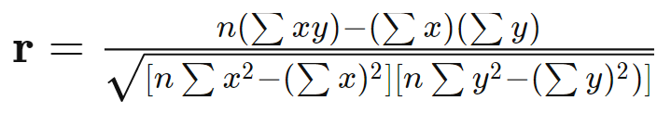

Computing Correlation
X | Y
1 | 2
2 | 4
3 | 7
4 | 9
5 | 12
6 | 14
21
48
211
91
490
This is “Pearson’s Correlation Coefficient”
More Details: https://www.investopedia.com/ask/answers/032515/what-does-it-mean-if-correlation-coefficient-positive-negative-or-zero.asp

Slide 11
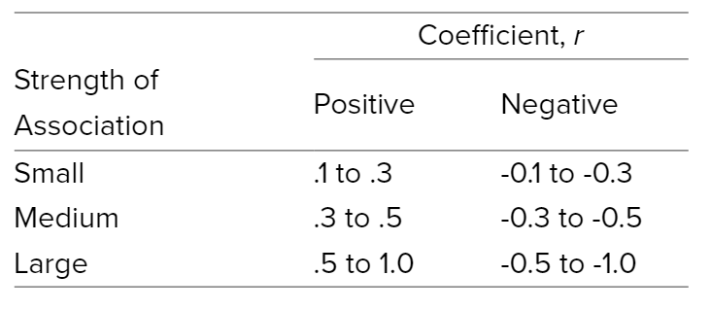
Correlation Interpretation
More Details: https://statistics.laerd.com/statistical-guides/pearson-correlation-coefficient-statistical-guide.php

Slide 12
Correlation does NOT imply causality…
if A and B are correlated, this does not necessarily imply that A causes B or that B causes A.
For example, in analyzing a demographic database, we may ﬁnd that attributes representing the number of hospitals and the number of car thefts in a region are correlated.
This does not mean that one causes the other.
Both are actually causally linked to a third attribute, namely, population.

Slide 13
Activity
Calculate Correlation between these two variables X, Y
X | Y
2 | 10
4 | 9
6 | 8
8 | 7
10 | 6

Slide 14
Activity
Calculate Covariance of the following two variables X, Y
X | Y
2.1 | 8
2.5 | 10
3.6 | 12
4 | 14

